Slide 1
Discrete Mathematics Induction and Recursion
by Akkradach W.
Dept. of Computer Engineering
KMITL

Slide 2
Agenda
Chapter 4
Mathematical Induction
Recursive Definitions and Structural Induction
Recursive Algorithms

Slide 3
Mathematical Induction
It is just an important proof technique and it is a deductive reasoning
Let n ∈ Z⁺, ∀P(n) is true if
P(1) AND ∀k(P(k) → P(k+1)) are true
[P(1) ∧ ∀k(P(k) → P(k+1))] → ∀P(n)
Are they true?
1+2+…+n = n(n+1)/2
n < 2^{n}
(n³ – n) is divisible by 3

Slide 4
Proving Summation Formulae
If n ∈ Z⁺ then 1+2+…+n = n(n+1)/2
Basis step:
P(1) is true, because 1 = 1(1+1)/2
Inductive step:
Assume P(k) is true
(1) – 1+2+…+k = k(k+1)/2
It must be shown that P(k+1) is also true
(2) – 1+2+…+k+k+1 = (k+1)[(k+1)+1]/2 = [(k+1)(k+2)]/2
When we add k+1 to both sides of (1) then
(3) – 1+2+…+k+(k+1) = k(k+1)/2 + (k+1) = [(k+1)(k+2)]/2
Then P(k+1) is true as P(k) is true.

Slide 5
Proving Inequalities
If n ∈ Z⁺ then n < 2^{n}
Basis step:
P(1) is true, because 1 < (2¹ = 2)
Inductive step:
Assume P(k) is true
(1) – k < 2^{k}
It must be shown that P(k+1) is also true
(2) – k+1 < 2^{k+1}
When we add 1 to both sides of (1) then
(3) – k+1 < 2^{k}+1 which ≤ [2^{k}+2^{k} = 2(2^{k}) = 2^{k+1}]
Then P(k+1) is true as P(k) is true.

Slide 6
Proving Divisibility Results
If n ∈ Z⁺ then (n³ – n) is divisible by 3
Basis step:
P(1) is true, because (1³ – 1) = 0 is divisible by 3
Inductive step:
Assume P(k) is true
(1) – (k³ – k) is divisible by 3
It must be shown that P(k+1) is also true
(2) – ((k+1)³ – (k+1)) is divisible by 3
And (2) = (k³ +3k²+3k+1) – (k+1)
= (k³ – k) + 3(k² + k) which both terms are divisible by 3
Then P(k+1) is true as P(k) is true

Slide 7
Recursive Definitions and Structural Induction
With set of nonnegative integers,
Basis step: Specify the value of f(0)
Recursive step: Give a rule for finding its value at an integer from its value at smaller integers
f(0) = 3
f(n+1) = 2f(n)+3
f(1), f(2), f(3), f(4) = ?

Slide 8
Factorial function
F(0) = 1
n = 1, 2, 3, …
F(n+1) = (n+1)F(n)

Slide 9
Fibonacci Numbers
f₀ = 0, f₁ = 1
n = 2, 3, 4, …
f_{n} = f_{n-1} + f_{n-2}

Slide 10
Set ∑* of strings
λ ∈ ∑*
If w ∈ ∑* and x ∈ ∑, then
wx ∈ ∑*
λ is the empty string
∑ is the set of symbols
∑ * is the set of strings from ∑

Slide 11
String concatenation
If w ∈ ∑*, then w ⋅ λ = w
If w₁ ∈ ∑*, w₂ ∈ ∑* and x ∈ ∑, then
w₁ ⋅ (w₂x) = (w₁ ⋅ w₂)x
λ is the empty string
∑ is the set of symbols
∑ * is the set of strings from ∑

Slide 12
Recursive Algorithms
An algorithm is called recursive if it solves a problem by reducing it to an instance of the same problem with smaller input

Slide 13
n!
factorial(n: nonnegative integer)
if n = 0 then
factorial(n) := 1
else
factorial(n) := n ⋅ factorial(n-1)

Slide 14
Recursive VS Iterative Codes
rfac(n)
{
return n>=1 ? \
n * rfac(n-1) \
: 1;
}
ifac(n)
{
int ans=1; int i;
for(i=1;i<=n;i++)
ans *= i;
return ans;
}

Slide 15
Fibonacci
fibo(n: nonnegative integer)
if n = 0 then
fibo(n) := 0
else if n = 1 then
fibo(n) := 1
else
fibo(n) := fibo(n-1) + fibo(n-2)

Slide 16
Recursive VS Iterative Codes
rfibo(int n)
{
if (n==0) return 0;
if (n==1) return 1;
return rfibo(n-1) + \
rfibo(n-2);
}
ifibo(int n)
{
int pprev = 0;
int prev = 1;
int ans = 0; int i;
if (n==0) return 0;
if (n==1) return 1;
for (i=2;i<=n;i++){
ans = prev + pprev;
pprev = prev;
prev = ans;
}
return ans;
}

Slide 17
a^{n}
power(a: nonzero real number, n: nonnegative integer)
if n = 0 then
power(a, n) := 1
else
power(a, n) := a ⋅ power(a, n-1)

Slide 18
Recursive VS Iterative Codes
power(a,n)
{
if (n==0) return 1;
else
return a * \
power(a,n-1);
}
power(a,n)
{
… HOW? …
}

Slide 19
Greatest Common Divisor
gcd(a, b: nonnegative integers w/ a<b)
if a = 0 then
gcd(a, b) := b
else
gcd(a, b) := gcd(b mod a, a)

Slide 20
Recursive VS Iterative Codes
rgcd(a,b)
{
if (a==0) return b;
else
return rgcd(b%a,a);
}
igcd(a,b)
{
… HOW? …
}

Slide 21
Binary Search
bsearch(x,i, j: integers w/ 1≤ i ≤n, i≤ j ≤n)
m = ⎣(i+j)/2⎦
if x = a_{m} then
location := m
else if (x < a_{m} and i < m) then
bsearch(x, i, m-1)
else if (x > a_{m} and j > m) then
bsearch(x, m+1, j)
else
location := 0

Slide 22
Recursive VS Iterative Codes
rbsearch(…)
{
… HOW? …
}
ibsearch(…)
{
… HOW? …
}

Slide 23
Merge Sort (1)
msort(L = a₁,…,a_{n})
if n > 1 then
m := ⎣n/2⎦
L₁ := a₁, a₂, …, a_{m}
L₂ := a_{m+1}, a_{m+2}, …, a_{n}
L := merge(msort(L₁), msort(L₂))

Slide 24
Merge Sort (2)
merge(L₁, L₂: sorted lists)
L := empty list
while L₁ and L₂ are both nonempty
Remove smaller of first element of L₁ and L₂ from the list it is in and put it at the right end of L
if one list becomes empty then
Remove all elements from the other list and append them to L

Slide 25
Merge Sort (3)
Lemma: merge()
L₁, L₂ with m, n elements respectively can be merged into a sorted list using no more than m+n+1 comparisons
Theorem: msort()
The number of comparisons needed to merge sort a list with n elements is O(n log n)

Slide 26
Ackermann's Function p=0,1,2
φ(m,n,p)
φ(m,n,0) = m + n
φ(m,n,1) = m · n
φ(m,n,2) = m^{n}

Slide 27
Ackermann–Péter Function
A(m,n)
If m=0 then
A(m,n)=n+1
If m>0 and n=0 then
A(m,n)=A(m-1,1)
If m>0 and n>0 then
A(m,n)=A(m-1, A(m,n-1))

Slide 28
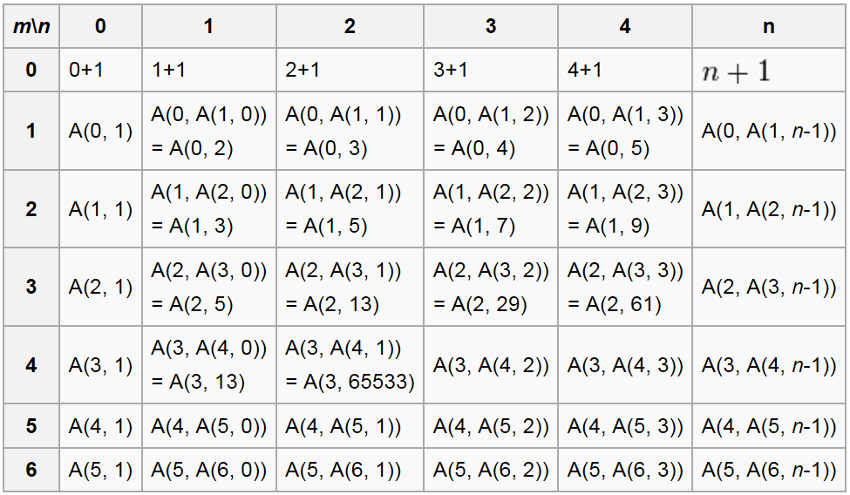
Pattern of A(m,n)

Slide 29
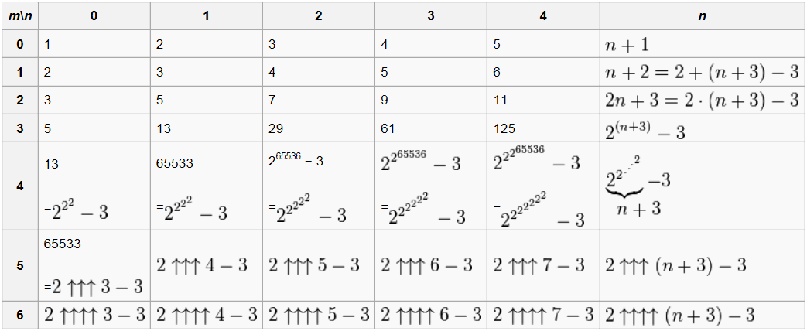
Value of A(m,n)

Slide 30
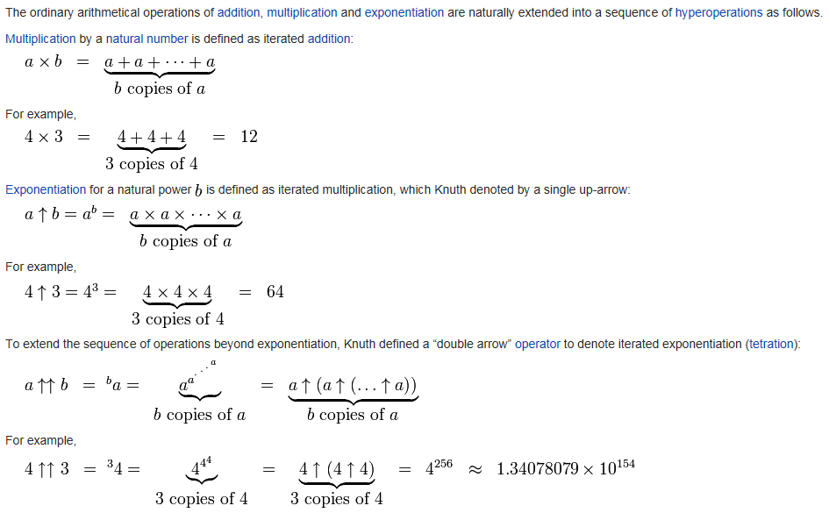
Knuth's Up-arrow Notation

Slide 31
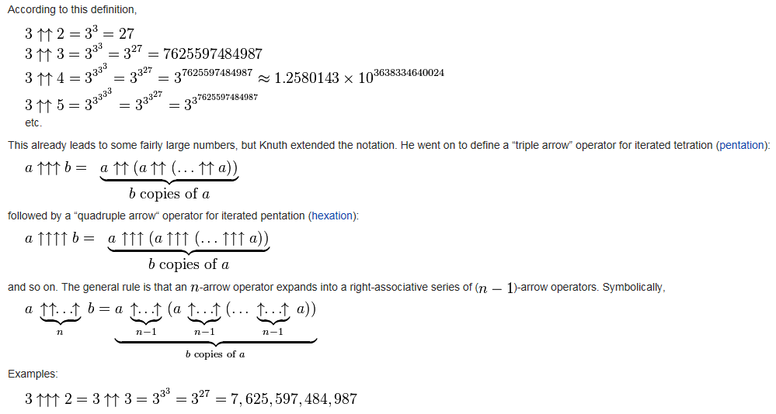
Such a huge!

Slide 32
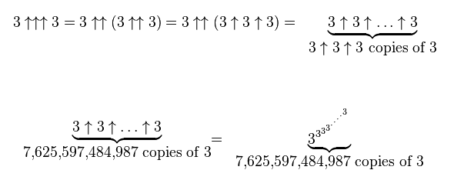
Very, very, very … HUGE!

